Slide 1

A Collegial Conversation: Leadership in Academic Program Coordination
Thursday, May 25, 2017 – 8:30 – 10:30

Slide 2
Please call me Ruthanne
Ruthanne.Krant@georgiancollege.ca
Who is a college graduate in this room?
Who obtained an undergraduate or graduate degree on a continuing education basis?
How many people here started your college involvement as an Advisory Committee member? Employer? Part-time teacher?
The Ontario College system is 50 years old – 30 plus years of college experience? 20 plus years? 10 plus years? 5 plus years? Less than 5 years?
Program Coordinator role for how many years? Less than 1? 1 – 5? 5 – 10? 10 – 15? More than 15 years?

Slide 3
Learning Outcomes
Develop a personal definition of collegial leadership and apply it to Academic Program Coordination roles;
Assess factors that contribute to and distract from a collegial work environment;
Identify roles and responsibilities that could be shared with colleagues (and student leaders) to distribute a Coordinator’s workload;
Strategize specific action steps that serve to enhance collegiality while minimizing the forces that add to a Coordinator’s workload and are detrimental to a collegial approach;
Create an action plan that identifies what could be stopped, started or continued to enhance collegial leadership within Co-ordinators’ roles at your College.

Slide 4

Personal Reflections
Early college experience
Part-time teacher since 1982
College administrator from 1985 to 2001
Thank-you Local 350!
Role as Program Coordinator

Slide 5
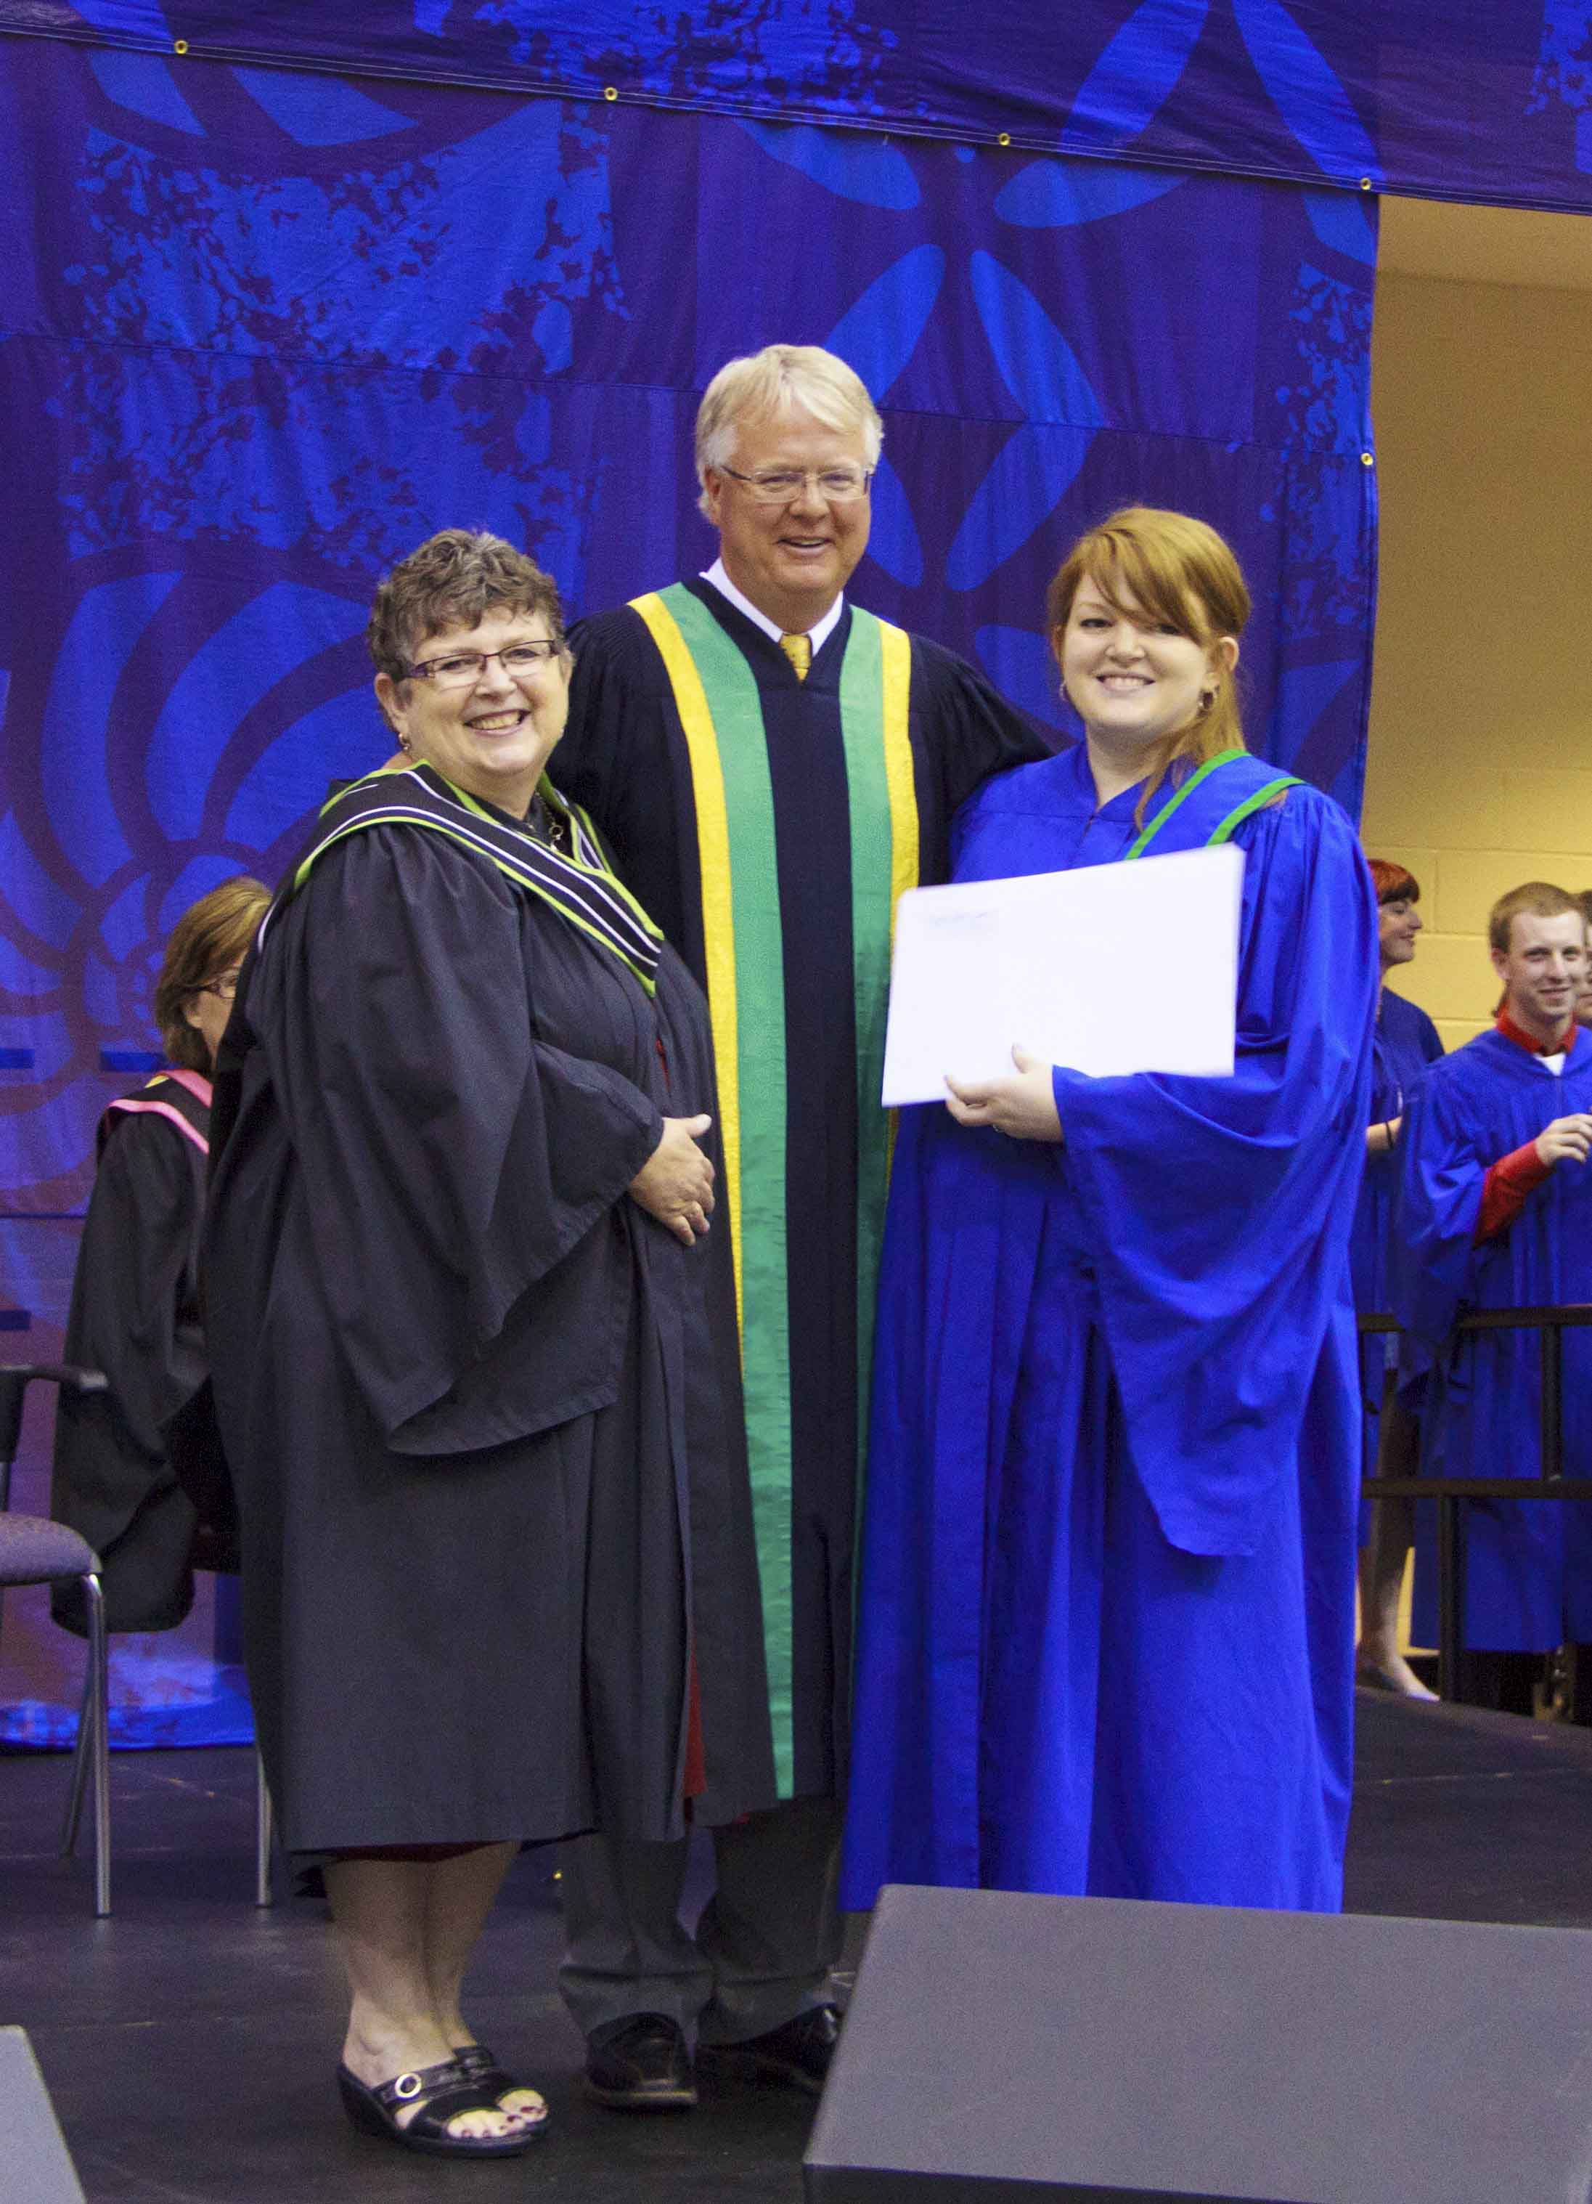
Influential Moments
The Leadership Challenge
James M. Kouzes & Barry Z. Posner, 4th Edition, 2010
https://twitter.com/tlctalk

Slide 6

Influential Authors
http://www.couragerenewal.org/courage-to-teach

Slide 7
“Are Teachers Really Leaders in Disguise?”
http://www.psychologytoday.com/blog/cutting-edge-leadership/201006/are-teachers-really-leaders-in-disguise
Yes, we are!

Slide 8
Personal Definition
Pg. 2 – Work Sheet
What does the word ‘collegial’ mean to you?
What are the characteristics or behaviours associated with ‘collegial leadership’?

Slide 9
A Collegial Approach in Understanding Leadership
“Traditional management implies that the ideal organization is orderly and stable, that the organizational process can and should be engineered so that things run like clockwork.” (Kouzes & Posner, 2007)
“Collegiality, on the other hand, is a collaborative process that entails the devolution of power to teachers and other stakeholders in order for them to become an integral part of the leadership processes of the school that are guided by the school’s shared vision.” (Sergiovanni, 1991)

Slide 10
Collegiality = Collaboration?
“To be successful, teams must adopt a www.com (we will win) mind-set, and not an imm.com (I, me, myself) mind-set.”
  Lily Cheng, PACE Learning & Consultancy, Singapore
  (Kouzes & Posner, 2010)

Slide 11
Kouzes and Posner on Leadership
“Leaders know that no one does his or her best when feeling weak, incompetent or alienated; they know that those who are expected to produce the results must feel a sense of ownership.”
Leadership without authority?
“People in positions of authority can get people to do something because of the power they wield, but leaders mobilize others to want to act because of the credibility they have.”

Slide 12

Trust Kouzes and Posner (2010)
“Leadership is a relationship between those who aspire to lead and those who choose to follow.”
“The heart of this relationship is trust.”
“The more trusted people feel, the better they innovate.”

Slide 13
Contributing and Distracting Factors
- p. 2 of Work Sheet
+ ve forces
- ve forces
What are the factors within your College and Program that contribute to collegiality?
LEAP & related faculty development
Other full-time faculty and Program Coordinators in your school/department
Base Camp – project management tool to assist with program renewal
What are the factors that distract from a collegial work environment?
High ratio of part-time teachers within your Program
Administrators who don’t encourage collegial relationships
Increased accountability within public education

Slide 14
Large Group Discussion: Contributing & Distracting Forces
Forces for collegiality
Factors against collegiality

Slide 15
“A Common Position Description”
Review of yesterday’s discussion regarding common roles and responsibilities.
“Taking the leap” – further reflections on the barriers to delegation of tasks.
“Shared leadership” success stories

Slide 16

Action Planning
Pg. 3 – Work Sheet
Strategize specific action steps that serve to enhance collegiality while minimizing the forces that add to a Coordinator’s workload and are detrimental to a collegial approach.

Slide 17


Action Planning
Within your sphere of influence, identify what can be:
Stopped
Started
Continued
to enhance collegial leadership within Coordinators’ roles at your College.
Is there ONE action that you can take back to your College to implement?

Slide 18
Honouring Our History:
Team Based Leadership and Learning
(Terry Dance-Bennink, former V.P., Academic, Sir Sandford Fleming College, A Leadership Abstract, April 1999)
“How can we expect college students to become good team players if college staff lack those skills ourselves?”
“How can we expect faculty to promote collaborative learning activities if they are treated in an authoritarian, top-down manner by ‘management’?”
How can a college respond quickly to student needs if decisions are slowed by layers of bureaucracy?”

Slide 19
Collegial Leadership: University Sector
(Dr. Paul Davenport, former President, Western University)
Others have knowledge we don’t have – they need space to act, succeed and occasionally fail.
Our job is to listen to others on campus, work with them to set directions which we all agree on, and then monitor progress and cheer on success.
Our moral authority is key: leadership by example isn’t one way of leadership, it’s the only way.
Leadership rests on communication and making choices.

Slide 20
What are the advantages of collegial leadership?
Teachers participate fully in the management and leadership of the school;
The quality of decision-making is improved when the teaching staff participate in this process and take the lead in finding solutions to problems;
The contribution of the teaching staff is important because they take the responsibility of implementing changes in policy.

Slide 21
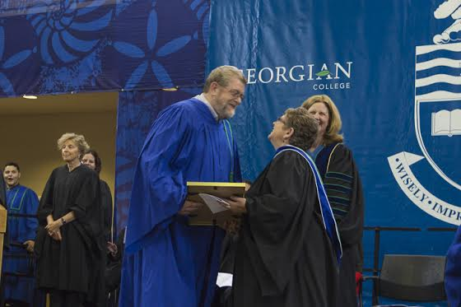
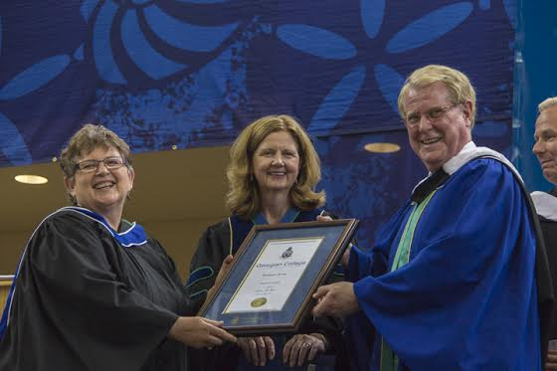
Proud Moments

Slide 22
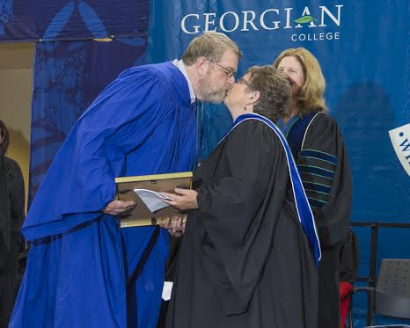
Memorable Moments

Slide 23


